Slide 1

An IDSS for Police Patrol Planning in Los Angeles
Presented by: Renato Gallicola, Emilien L’Haridon, Domenico Pazienza, Arthur Rasera

Slide 2
System Objectives
Core Features:
Crime prediction and visualization to understand high-risk areas.
Dynamic resource allocation to deploy officers effectively.
Automated shift scheduling for seamless operations.
Interactive tools for supervisors to track officer schedules.
Goal: Striking a balance between improving public safety and maintaining officer well-being.

Slide 3

Domain of Application
Sector: Public Safety and Law Enforcement.
Focus Area: Enhancing crime prediction and optimizing police resources.
Benefits:
Building greater community trust through proactive measures.
Preventing crimes before they happen.
Ensuring fair and effective workload management for officers.

Slide 4

Decision Highlights
Crime Prediction:
Anticipates crimes based on historical data using an LSTM model.
Focuses resources on high-risk areas for proactive action.
Visualization:
Uses heatmaps to highlight crime hotspots for easy interpretation.
Facilitates quick identification of priority areas.
Resource Deployment:
Allocates patrols efficiently with dynamic algorithms.
Balances risk severity and resource availability.
Officer Assignment:
Minimizes travel times using a linear optimization model.
Promotes fairness in workload distribution.
Shift Scheduling:
Automates weekly shift assignments for balanced workloads.
Supports officer readiness and well-being.

Slide 5
Dataset Overview
Data Sources:
Historical crime data (2020–2024) from official Los Angeles records.
Attributes: Crime type, time, date, latitude, longitude, and contextual metadata.
Synthetic officer location data: Generated to simulate privacy-respecting residential data.
Dataset Size:
Over 1 million crime entries spanning a 4-year period.
Purpose: Forms the foundation for crime prediction, resource allocation, and visualization components

Slide 6

Data Preprocessing
Data Cleaning: Removed irrelevant and incomplete data for better model reliability.
Feature Engineering: Extracted and transformed temporal (e.g., shifts, months) and spatial features (latitude, longitude).
Handling Missing Data: Used imputation and row removal to ensure data consistency.
Synthetic Data Generation: Balanced datasets with negative samples for robust training.
Standardization: Normalized numerical data for consistent feature scaling.
Cyclical Encoding: Applied sine and cosine transformations to time variables like months and days.

Slide 7
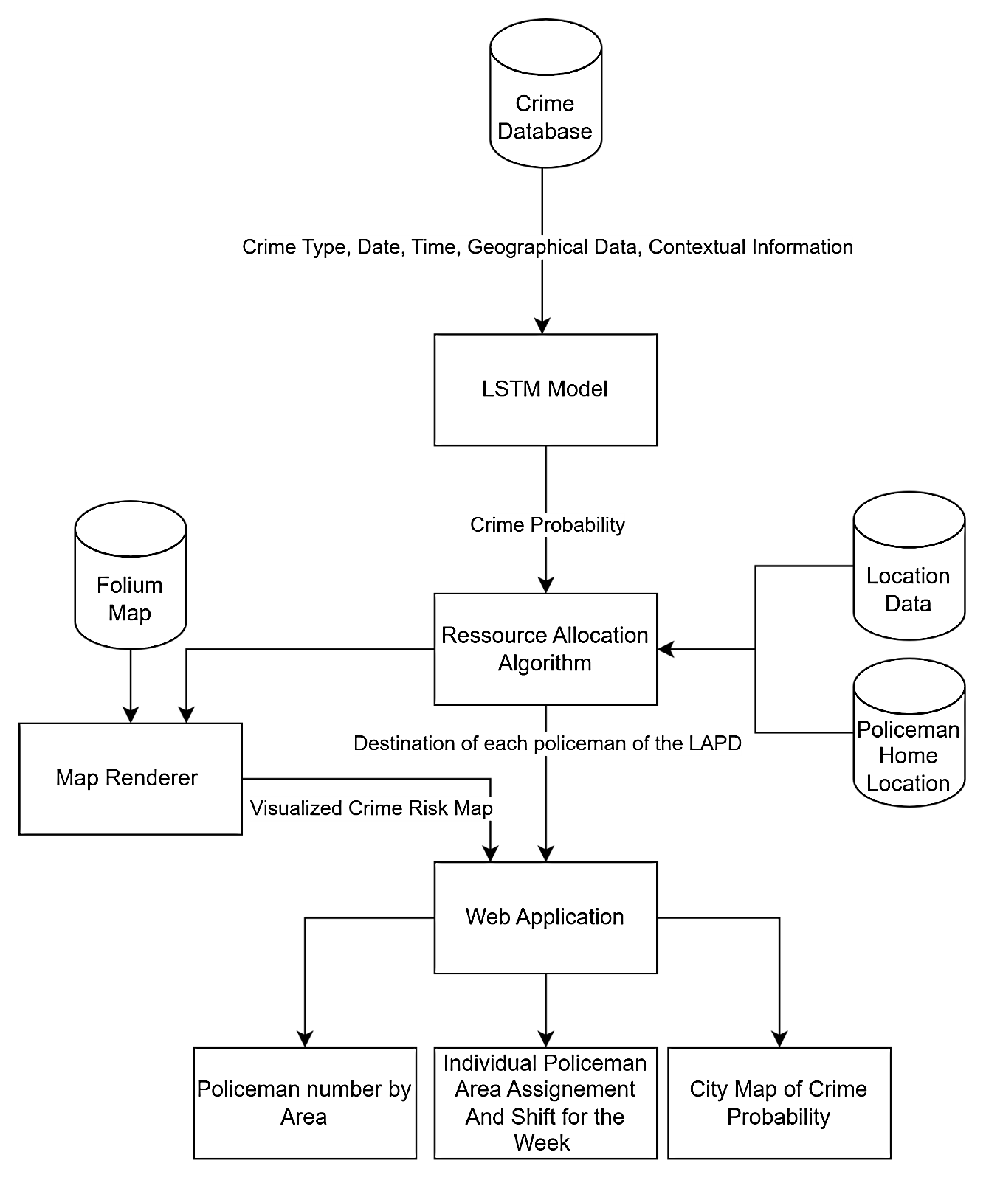
Functional Architecture
Overview: The system’s architecture is built around several key components:
An LSTM model for crime prediction.
A Resource Allocation Algorithm for optimal deployment.
A Map Renderer for interactive visualization.
A Web Application to bring it all together.
Key Components:
Temporal and spatial analysis through the LSTM model.
Algorithms for efficient resource allocation.
Visualization tools for intuitive insights

Slide 8
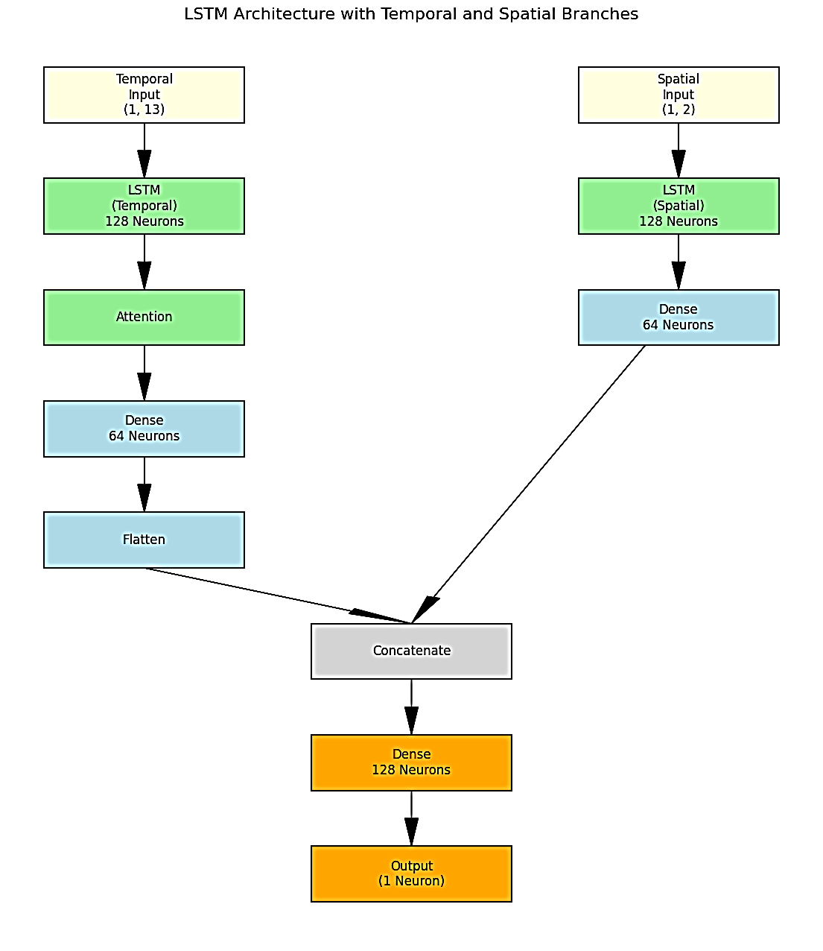
LSTM Model Architecture
Purpose: To accurately predict the probability of crimes based on historical data.
Inputs:
Temporal features, such as time of day and day of the week.
Spatial features, including geographical coordinates.
Model Structure:
Temporal LSTM with 128 neurons and attention mechanisms to capture critical time patterns.
Spatial LSTM with 128 neurons to understand location-based trends.
Dense Layers for refining and combining predictions.

Slide 9
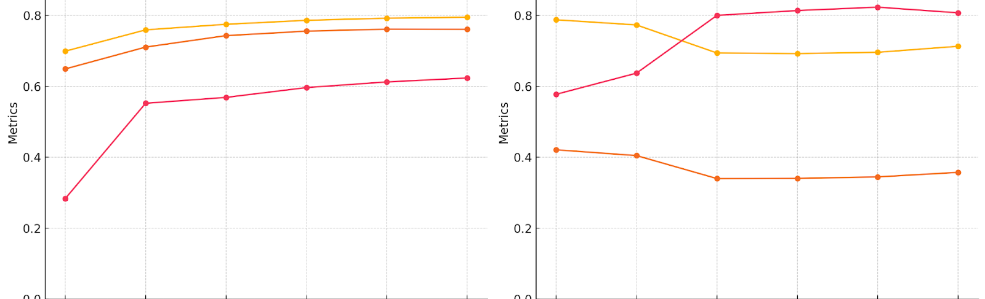
LSTM Model Performance
Training Metrics:
Accuracy: Measures the percentage of correct predictions during training, achieving around 80%.
Precision: Evaluates the proportion of correctly identified crime zones among all predicted positives, ensuring reliable hotspot detection.
Recall: Highlights the ability to identify high-risk zones accurately, ensuring minimal false negatives.
Testing Metrics:
Precision | 0.61
Recall | 0.54
Accuracy | 76%

Slide 10

Resource Allocation Algorithm
Objective: To minimize delays and evenly distribute workloads among officers.
Inputs:
Crime probability predictions.
Officer home locations.
Distance and time constraints.
Output:
Optimal assignments of officers to high-risk zones.
Optimization Techniques:
Linear programming ensures fairness and efficiency in allocation.

Slide 11
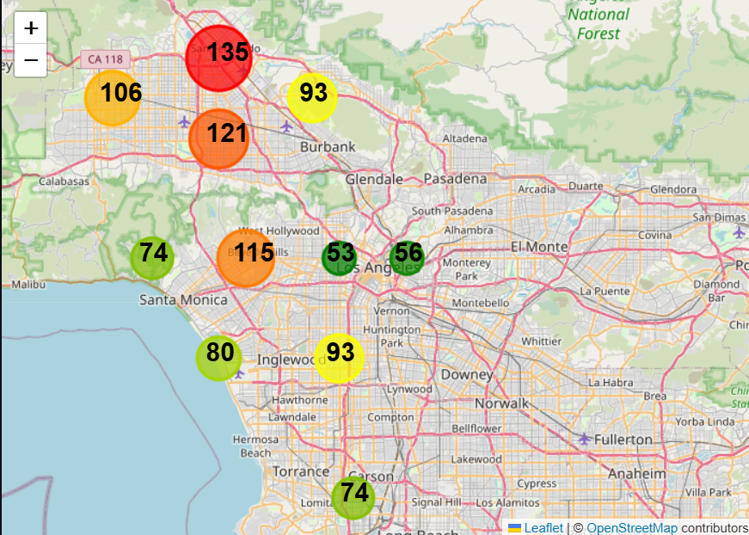
Map Renderer
Purpose: To make crime predictions visually accessible and actionable.
Features:
Grid-based heatmaps to highlight high-risk areas.
Folium-based maps for interactive exploration.
Aggregation of smaller zones into broader, more manageable areas.
Outcome: Enables quick decision-making and targeted resource allocation.

Slide 12
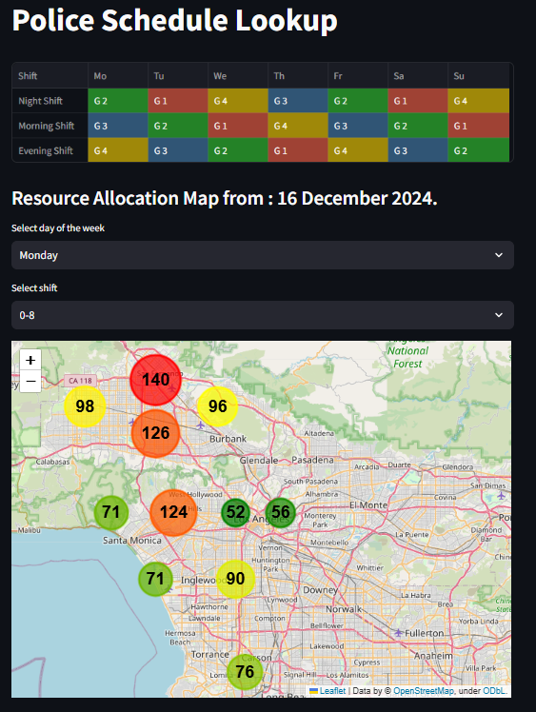
Dashboard Demo: Police Dispatch IDSS
Purpose: To manage officer deployment and model execution.
Features:
Input fields for setting the total number of officers and selecting valid dates.
Click-to-run functionality to execute the model and generate resource allocation plans.
Police Schedule Lookup: Displays weekly shift allocations for night, morning, and evening shifts using color-coded tables.
Resource Allocation Map: An interactive map showing the number of officers allocated to each high-risk area

Slide 13
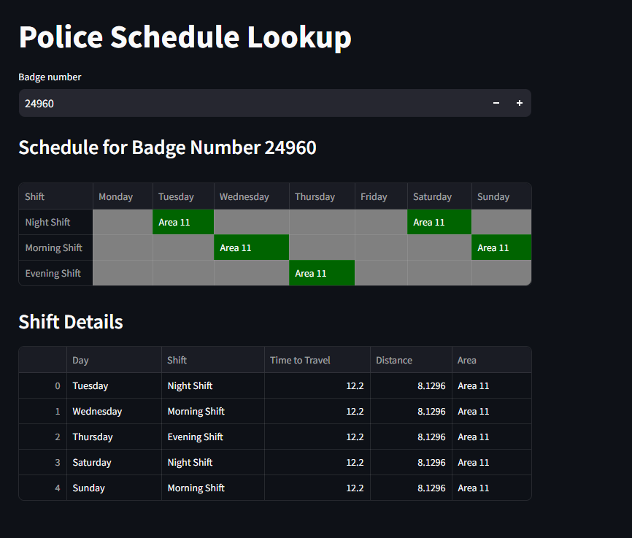
Dashboard Demo: Police Schedule Lookup
Dashboard Demo: Police Schedule Lookup
Purpose: Provide officers with personalized schedules and detailed shift information.
Features:
Badge Number Lookup: Input an officer’s badge number to retrieve weekly schedules.
Schedule Table: Visualizes shifts (night, morning, evening) and assigned areas for the selected officer.
Shift Details: Detailed breakdown including day, shift type, travel time, distance, and patrol area.
Outcome: Enhances officer efficiency with clear and accessible schedule details.

Slide 14
Future Improvements
Smart City Integration:
Incorporate IoT data for greater situational awareness.
Utilize smart devices to gather real-time information on emerging crime trends.
Public Safety Enhancements:
Provide real-time alerts and notifications to officers.
Offer quick responses to dynamic, on-field requirements.
Interactive Dashboards:
Enable supervisors to monitor live resource allocations.
Improve decision-making through real-time performance metrics.

Slide 15

Q&A
Thank you for your attention!
Questions and Feedback?

